Slide 1

Model Driven Information Sharing and Analytics
Using threat and risk examples
Cory Casanave

Slide 2

Frictionless World Ideal
Everything works with everything else, securely
Information from multiple sources can be correlated, analyzed and leveraged – accurately
We can collaborate with anyone – inside or outside of our enterprise – instantly
This is an ideal, we will never get there. But…

Slide 3

Where are we? How far can we go?
How do we get to 8?
0
2
8
10
Frictionless Scale
Frictionless Scale
First
Computers
Now
Art of the possible
Impossible
Ideal
Things work together because they were designed to work together
Independently conceived things work together
ATM Cards and worldwide sharing of cat videos
Most processes, services and information I care about are easily available

Slide 4
Semantic Mediation
Using stakeholder centric conceptual models of “reference concepts” as a “pivot point” between different data, schema, technologies, organizations and stakeholders

Slide 5
Semantic Modeling for Information Federation
Capability – Information Federation, Synthesis & Analytics
Ingest and interpret information and processes from multiple divergent sources
Situational awareness
Federated analytics “Connecting the dots”
Joint missions and desperate industries
Risk reduction
Capability – Information Sharing & Brokerage
Translate information between diverse sources and consumers
Configurable gateways for diverse schema and protocols
Systems integration
Capability – Design for Interoperability
Instead of designing “from scratch”, use conceptual models as the foundation for new systems. This reduces cost and errors while building in interoperability. Leverages MDA model execution & Code/Schema Generation. Can forward engineer to semantic web.

Slide 6
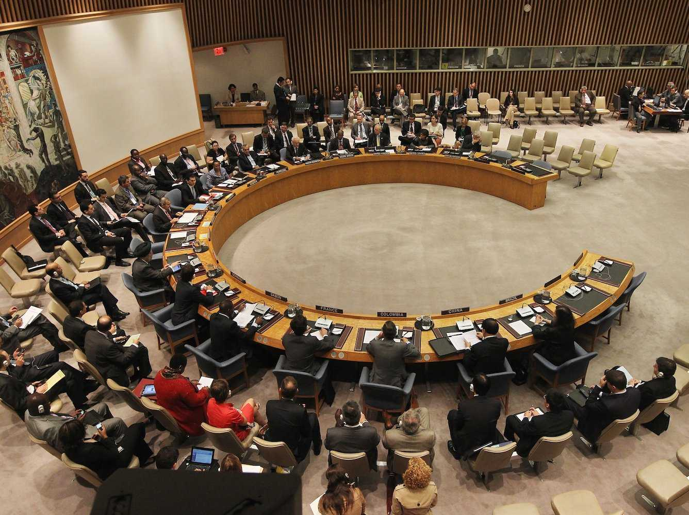

Analogy: Role of the interpreter

Slide 7
What we expect of interpreters
Retention of meaning across languages, communities and cultures
Communicate what is said without judging, coloring or filtering it
Interpreters leverage substantial preparation; learning syntax, grammar, vocabulary and cultural idioms.
Interpreters can only communicate what they understand and what can be understood in the languages they deal with – the common concepts
They then communicate what other people said based on how those concepts are expressed in different languages – they also communicate the provenance
Interpreters are preforming semantic mediation
Common concepts

Slide 8
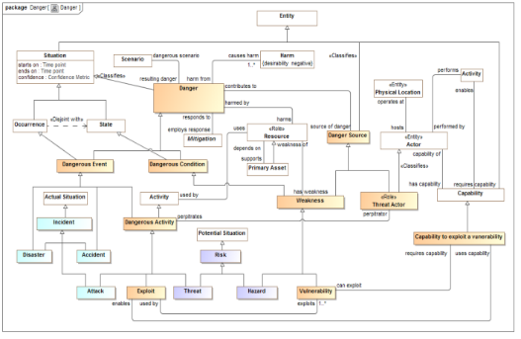
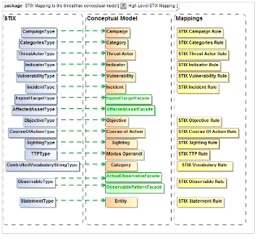
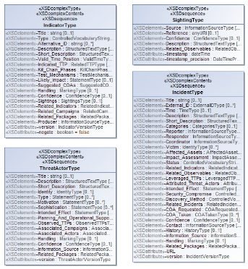
Semantic Mediation Reference Models
We need to understand
What are the common concepts
How do the various information syntaxes represent those concepts
What are the rules for translating between them in various context
Information
Syntax
Represents
Reference
Concepts
Information
Syntax
Represents
Represents
Information
Syntax
Conceptual Model
Mapping Rules
Information Model

Slide 9

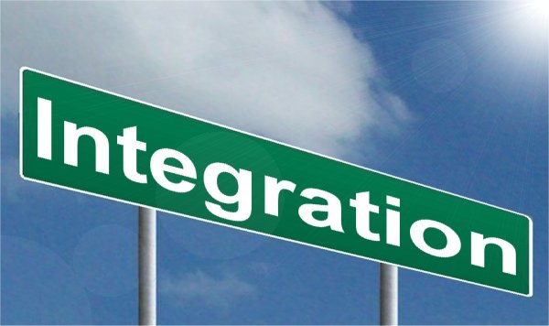
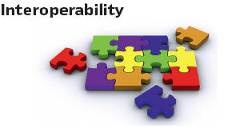



Leveraging Federated Information
T

Slide 10


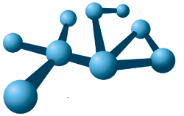
Semantic Mediation is being used
FIBO
Operational Threat & Risk
Wide scale model of concepts in the financial domain
Federated Concept Library
Interoperability and data federation of threat and risk information – cyber and physical

Slide 11
Example: Integrating framework that supports automated data mapping analytics
Cyber
Crime
Terrorism
Critical Infrastructure
Natural
Disasters
Integrating Framework for Threats and Risks
Sharing & Analytics
Sharing & Analytics
Sharing & Analytics
Sharing & Analytics
Sharing & Analytics
An integrating framework that helps us deal with all aspects of a risk or incident
A federation of risk and threat information sharing and analytics capabilities

Slide 12


Federating Conceptual Model Inputs
KDM
(Risk)
NIST Framework
Conceptual Model
NIEM
(General)
STIX
(Cyber)
OGC
(Geo)
EDXL
(Emergency)
FIBO (Finance)
SEI
(Safety)
CAL OES
(Health)
MAP
ISO
(Risk)
ISO
(Units)
RMS
(Custody)
STIX, NIEM, EDXL, Others

Slide 13
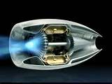
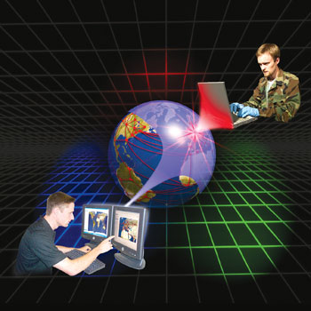
Federating Information
STIX
Cyber Information
Federated with the conceptual model
NIEM
(Justice and public safety)

Slide 14
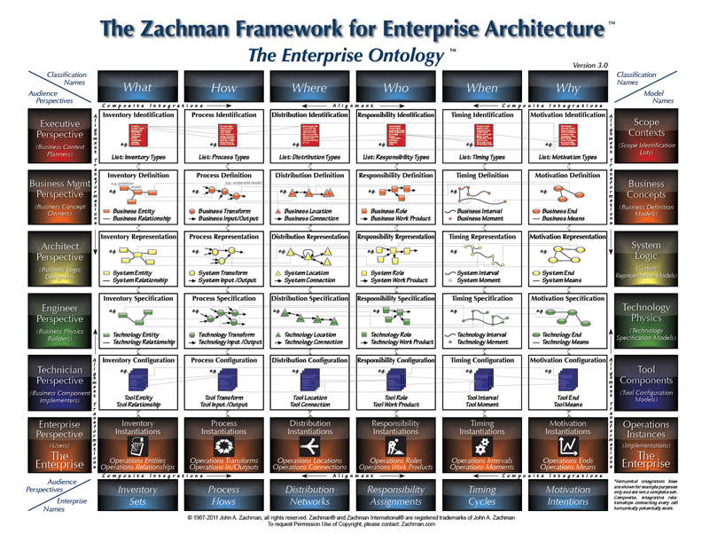
Solution Architecture

Slide 15
Model Driven Architecture (MDA)
http://www.omg.org/cgi-bin/doc?ormsc/14-06-01
Modeling Language & Profile
(E.g. UML, OWL)
Implements
Uses
MDA Tooling
Automates
Modeling Tool
Users Domain
Model
Provisioning
Engine
Uses
Technology Choices
Provisioning Model
Platform & Tools (E.G. Eclipse/Netbeans/.NET)
Static or
Dynamic
Application
Deploy
Manual
Platform
Application
Artifacts
Automated
Platform
Application & IDE
Artifacts

Slide 16
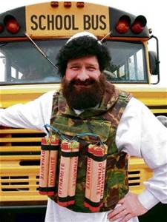
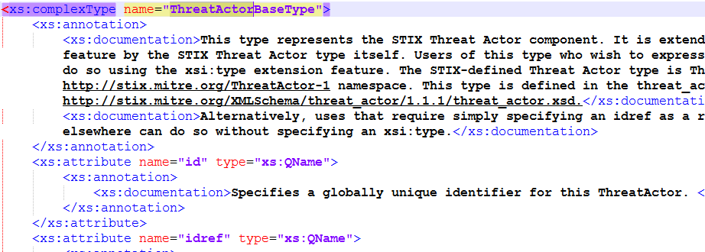
Example: What is a threat actor?
Dictionary
A threat actor, also called a malicious actor, is an entity that is partially or wholly responsible for an incident that impacts – or has the potential to impact -- an organization's security.
Threat
Actor
Concept
?
Data
About
Data element, not a threat actor.

Slide 17
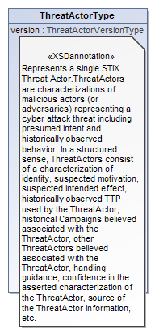
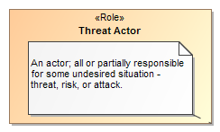
Data represents concepts
Represents

Slide 18
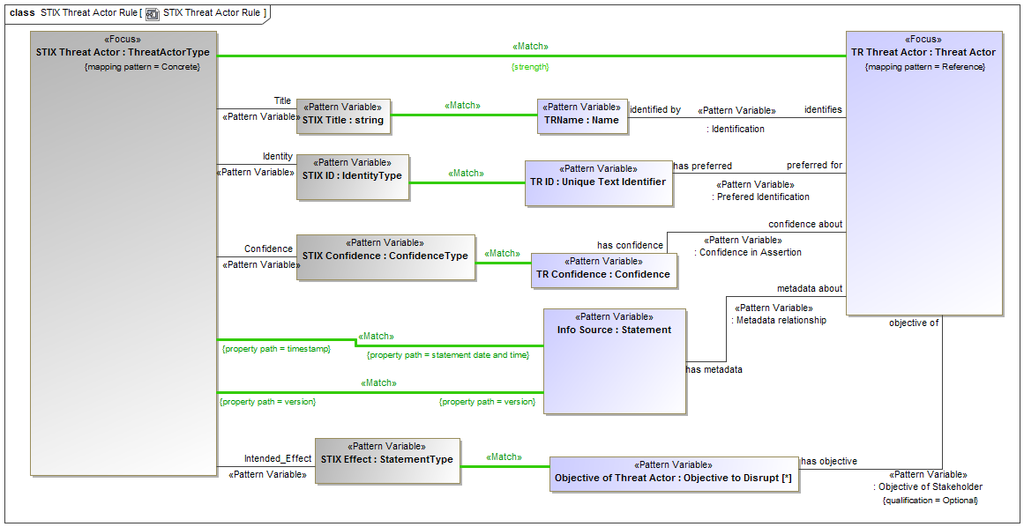
Example of Mapping Pattern (UML Profile)
Not Intended to be
Read

Slide 19
Use Case: Large Company
Company with multiple datacenters, office facilities, international business activity
Large number of deployed security systems, sensors
Firewalls, IDS/IPS, SIEM, monitoring systems, notification/alerting, etc.
Uses FW/Snort rules, STIX/TAXII, IODef, alarms for fire and intrusions, etc.
Physical and information security staff, some 24/7
Interoperable (but not uniform) threat monitoring and assessment

Slide 20
Use Case – Critical Infrastructure
Target: A group of organizations that collaboratively manage critical infrastructure and utilize Industrial Control Systems.
Power, water and other critical infrastructure are threatened by cyber and physical terrorism.
Industrial Control Systems are increasingly computer controlled and connected (directly or indirectly) to the internet and may embed compromised control hardware/software from questionable sources.

Slide 21



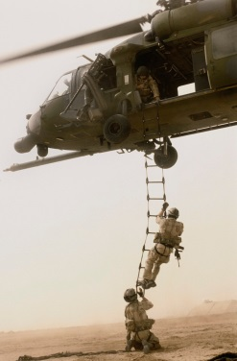



Potential Information Flows
Suspicious Activity Report
NIEM
Incident
Arrest Report
STIX Incident
Tactical Response Unit
Fusion Center
Intelligence
Report
IT System Hardening
Manual Shutdown
Public CAP Warning

Slide 22

Example - Snowmageddon
In January 2015 Massachusetts faced the Hazard of major winter storms across the region. Potential Harm from blizzards and winter storms includes negative economic impact, limited road accessibility, restricted emergency management, non-availability of utility, property damage, personal injury and death, and more.
The onset of a winter storm or blizzard was predicted by the National Weather Service (NWS).

Slide 23
Who needs to share and analyze storm information?
National Weather Service
Emergency Management
Electric Grid
Roads & Bridges
Cyber Availability
Evacuation
Cyber Vulnerability
International Partners
Hospitals
Evacuation Centers

Slide 24

Take away
There are critical needs that need to be addressed by government
We have standards that can be game changing to address those needs
We have technologies, products and services in place that implement these standards
There is expertise and training to use them
Lets use these standards, technologies and best practices!

Slide 25

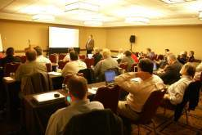
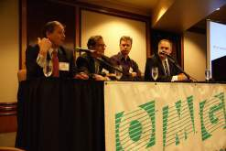
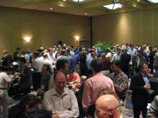
Who Is OMG?
Object Management Group (OMG):
Founded in 1989
More than 470 member companies
The largest and longest standing not-for-profit, open-membership consortium which develops and maintains computer industry specifications.
Continuously evolving to remain current while retaining a position of thought leadership.
Notes:
Which are membership requests, submits, develops and maintains To help achieve the objectives of Reusability, interoperability and portability
These standards are requested, submitted, adopted and maintained by the membership.

Slide 26




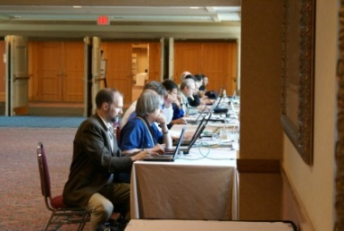
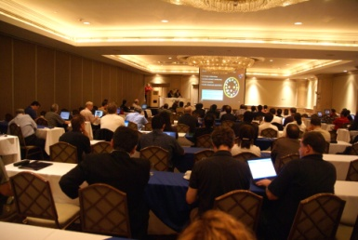
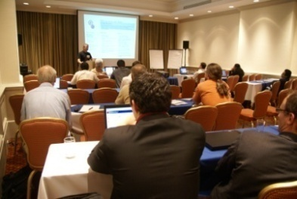
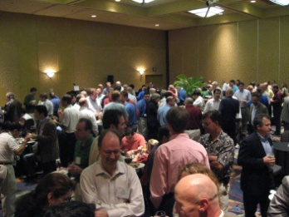
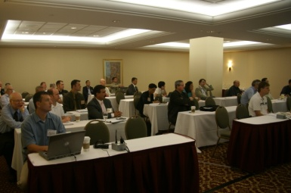
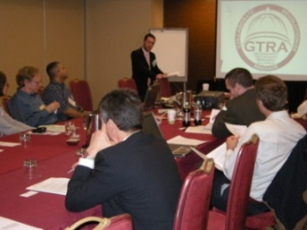
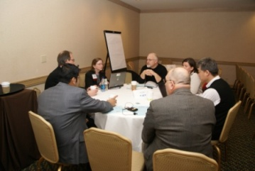
Developing Standards
Standards are developed using OMG’s mature, worldwide, open development process. With over 20 years of standards work, OMG’s one-organization, one-vote policy ensures that every vendor and end-user, large and small, has an effective voice in the process.
Notes:
26

Slide 27






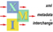
OMG’s Best-Known Successes
Common Object Request Broker Architecture
CORBA® remains the only language- and platform-neutral interoperability standard
Unified Modeling Language
UML® remains the world’s only standardized modeling language
Business Process Modeling Notation
BPMNTM provides businesses with the capability of understanding their internal business procedures
Common Warehouse Metamodel
CWMTM, the integration of the last two data warehousing initiatives
Meta-Object Facility
MOFTM, the repository standard
XML Metadata Interchange
XMI®, the XML-UML standard

